Slide 1


HEXA project
Group 112
Ahmed Mahmoud
Shehab Sherif
Seif Ahmed
Sadek Mohammed Mohammed Hamdy
10th Grade 1st Semester 2020-2021, 6th October STEM HIGH School for boys

Slide 2
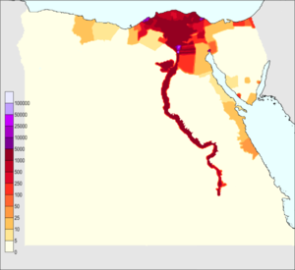
Introduction
The major grand challenge is urban congestion where 95% of the Egyptian population are concentrated around the Nile, where its main cause is the lack of water resources
The Specific problem is collecting wasted rain water to start land reclamation processes and solve the problem of urban congestion.
The chosen solution is finding new resource of water and rain water was chosen as it is more pure and available.

Slide 3
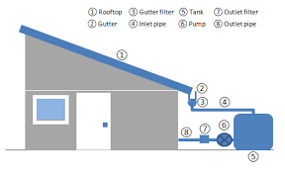
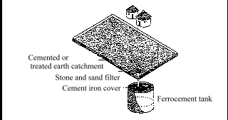
Prior solutions
The rooftop water collector
collecting rainwater and transferring it to a tank by a system of gutters.
One advantage is providing high-quality water for domestic use.
One disadvantage is that the water can get contaminated by the corpses of the small animals.
The ground catchment.
It uses compacted or cement soil with enough slope to collect the rainwater in an underground tank.
One advantage is providing water for whole families in a small community rather than individual roof top systems.
One disadvantage is that the maintenance of the underground tank will be difficult.

Slide 4


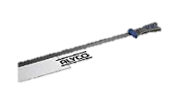
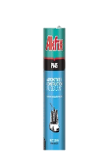

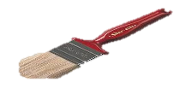
The design requirement is collecting the largest amount of water at the least time.
Materials
Building material
coating material
Cutting tool
Craft sticks
Kemapoxy150
Hard point tenon saw
Chosen glue
Yellow PVA
Chosen adhesive
Covering tool
polyurethane caulk
paint brush

Slide 5
DEFINE THE GRAND CHALLENGES
DEFINE THE PROBLEM
PRIOR SOLUTIONS
WHAT IS YOUR PROJECT (BREIF)
DESIGN REQUIREMENTS
Videos for Methods and test plan
Keep your explanation in points (bullets)
Put figures on the presentation

